Slide 1
Brent Taylor/Kai Zhang
September 2, 2014
Product Implementation Training (PIT)
IBM Case Manager 5.2.1
Solution Development: Extending the property view capability

Slide 2
Introduction
Course Overview:
  The course covers the topic of extending and customizing the properties view widget
Target Audience:
  Solution developer of IBM Case Manager
  L2 Support
Prerequisites:
  IBM Case Manager fundamentals
  IBM Content Navigator plugin development
  JavaScript, Dojo, IDX, HTML
Version Release Date: September 2014
© Copyright International Business Machines Corporation 2014. All Rights Reserved.
US Government Users Restricted Rights - Use, duplication or disclosure restricted by GSA ADP Schedule Contract with IBM Corp.

Slide 3
Course Objectives
After this course you will be able to:
  Describe the options for extending the properties view
  Choose an appropriate approach, based on business needs, to customize the properties view
  Develop custom scripts or Extensions Packages for the properties view
  Deploy and test the custom assets

Slide 4
Course Roadmap
Background - the Properties View widget
Overview - extending the properties view
Extending the properties view with a scripting adapter
  Use case: customizing editor messages
Extending the properties view with an extensions package
  Use case: custom property editor
Course Summary

Slide 5
Background - the Properties View widget
Properties view - A core widget of ICM for users to interact with properties from the case, tasks, documents, and from external data sources.
Available on the default Add Case, Case Details, Add Task, Work Details pages.
Properties view employs the MVC architecture
  Editor: the view tier to present the property to the user.
  Controller: the controller tier connects the view tier and the model tier, providing the functionality of action coordination, input validation, change set management, etc.
  Model: the client-side representation of the persistent data.

Slide 6
Course Roadmap
Background - the Properties View widget
Overview - extending the properties view
Extending the properties view with a scripting adapter
  Use case: customizing editor messages
Extending the properties view with an extensions package
  Use case: custom property editor
Course Summary

Slide 7
Overview - extending the properties view
Extension points
  Registry configuration – configures the available editors and the suitable mapping between data types and editors
    Registry configuration is managed by RegistryManager. The module provides public APIs to merge customized registry configuration, enabling registering custom editors
  Integration configuration – configures the controllers mapping and their attributes and methods
    Integration configuration is managed by Integration.js. The module provides public APIs to merge customized integration configuration, enabling the use of custom controllers, custom data types, and customizing the attributes and methods of the controllers
Approaches
  Script Adapter widget
  Extensions package

Slide 8
Course Roadmap
Background - the Properties View widget
Overview - extending the properties view
Extending the properties view with a scripting adapter
  Use case: customizing editor messages
Extending the properties view with an extensions package
  Use case: custom property editor
Course Summary

Slide 9
Extending the properties view with aScript Adapter widget
Script Adapter is a handy option for hosting the scripts that extend the properties view
  Suitable for minor tweaks of the existing functionality
  Can be developed in Case Builder along with the solution. No additional tools are required
  Can be exported/imported along with the solution
  Not suitable for complex customizations (e.g., when the code needs to be separated into multiple modules)
  Not suitable for use globally as the Script Adapter widget is supposed to be used within a particular page

Slide 10
Course Roadmap
Background - the Properties View widget
Overview - extending the properties view
Extending the properties view with a scripting adapter
  Use case: customizing editor messages
Extending the properties view with an extensions package
  Use case: custom property editor
Course Summary

Slide 11

Use case: customizing editor messages
Expectation – String case property “Length of service” is enforced by a pattern to have YYMM format. Instead of the generic error message, you would like to clearly inform the user the input should be in the format of YYMM when the data fails in validation.

Slide 12
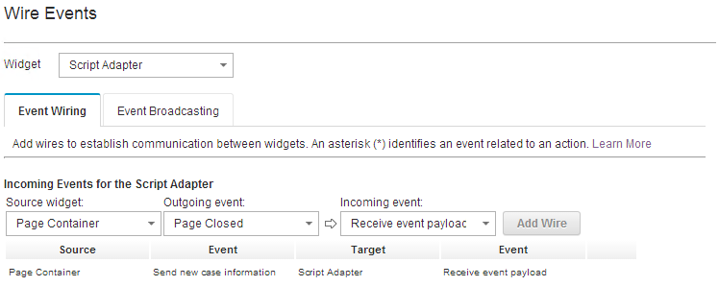
Use case: customizing editor messages (cont'd)
Add Script Adapter Widgets to the pages on which you want the message to appear, e.g., Add Case, Case Details, Work Details.
Wire the Script Adapter Widgets with the following events
  Send case information (for Case Details and Work Details page), or
  Send new case information (for Add Case page)

Slide 13
Use case: customizing editor messages (cont'd)
JavaScript code in the script adapter
require([
"icm/base/Constants",
"icm/model/properties/controller/ControllerManager"
], function(Constants, ControllerManager) {
// Retrieve the editable and the controller objects from the event payload.
var editable = payload.caseEditable;
var coordination = payload.coordination;
var collectionController = ControllerManager.bind(editable);
var controller = collectionController.getPropertyController("F_CaseFolder", "CARD_LengthofService");
// Use the LOADWIDGET coordination topic handler to obtain the controller binding
// for the editable and to update the properties.
coordination.participate(Constants.CoordTopic.LOADWIDGET, function(context, complete, abort) {
// Start a batch of changes
collectionController.beginChangeSet();
// Set the controller attributes
controller.set("promptMessage", "Enter the length of service in YYMM format.");
controller.set("invalidMessage", "The value of this property must be in YYMM format.");
controller.set("maxMessage", "The value of this property must be in YYMM format.");
// Complete a batch of changes. This tells the subscribed widget to refresh
collectionController.endChangeSet();
// Call the coordination completion method
complete();
});
// Use the AFTERLOADWIDGET coordination topic handler to release the controller
// binding for the editable.
coordination.participate(Constants.CoordTopic.AFTERLOADWIDGET, function(context, complete, abort) {
//Release the controller binding for the editable
ControllerManager.unbind(editable);
//Call the coordination completion method
complete();
});
});
Note: using the similar code you can customize the controller's attribute to implement your business needs, such as set a custom pattern to validate the value dynamically, or create your custom choice list programmatically.

Slide 14
Course Roadmap
Background - the Properties View widget
Overview - extending the properties view
Extending the properties view with a scripting adapter
  Use case: customizing editor messages
Extending the properties view with an extensions package
  Use case: custom property editor
Course Summary

Slide 15
Extending the properties view with an Extensions Package
An Extensions Package is a new piece of infrastructure introduced in ICM 5.2.1. It can be used to do advanced customization of the properties view, such as custom editors, custom data types, custom controllers ,etc.
  Suitable for advanced customization with multiple code modules
  Requires knowledge of developing IBM Content Navigator plugins
  Need separate steps to deploy; these steps are in addition to deploying the solution package
Extensions Package structure – a zip file consisting of
  ICN plugin jar – the custom code to be deployed to ICN
  ICMRegistry/Extensions.json – the manifest file for Case Builder

Slide 16
Course Roadmap
Background - the Properties View widget
Overview - extending the properties view
Extending the properties view with a scripting adapter
  Use case: customizing editor messages
Extending the properties view with an extensions package
  Use case: custom property editor
Course Summary

Slide 17

Use case: custom property editor
Expectation – a banking solution has a Boolean “Signature” property to indicate whether the client has provided a signature. The customer wants it to be displayed as Yes/No rather than True/False. When the signature is not clear, they want the property to be null.

Slide 18
Use case: custom property editor (cont'd)
Build a dojo widget implementing the functionality (i.e., layout two check boxes in the Dojo template; add handlers for onclick, etc.)
Add mixin's as the parent class for the widget, such as _EditorMixin.js, _TextMixin, etc.
The editor framework implements a "normalizedValue" attribute for the editor widget that normalizes the manner in which the edit widget sets and retrieves the value. In most cases, this attribute delegates to the "value" attribute.
  If the “value” attribute is available in the widget, and the value suits your needs, the widget will automatically be able to work with the framework
  If the “value” attribute is available but the you want to do special processing/converting in the value, you may override the "retrieveNormalizedValue" and "applyNormalizedValue" methods
  If the “value” attribute does not exist, you need to add it following Dojo's convention by creating “setValueAttr” and “getValueAttr” methods on the widget.

Slide 19
Use case: custom property editor (cont'd)
Our Yes/No widget is built from Dojo template, and no built-in “values” attribute available.. We create the attribute using the following code in the Widget's Dojo class
_setValueAttr: function(_val) {
if (typeof _val === "undefined" || _val == null) {
// The input value is neither yes nor no, uncheck both boxes.
this.yesNode.checked = false;
this.noNode.checked = false;
} else if (_val) {
// The input value is yes, check the yes box and uncheck the no box
this.yesNode.checked = true;
this.noNode.checked = false;
} else {
// The input value is no, check the no box and uncheck the yes box
this.yesNode.checked = false;
this.noNode.checked = true;
}
},
_getValueAttr: function() {
if (this.yesNode.checked) {
return true;
} else if (this.noNode.checked) {
return false;
} else {
return null;
}
}

Slide 20
Use case: custom property editor (cont'd)
Create the registry configuration for the editor widget
Create bootstrap JavaScript file to register the editor. The script must be invoked by both Case Builder and Case Client (ICN)
define([
"dojo/_base/declare", "yesnocheckbox/editors/YesNoCheckBoxEditor"
], function(declare, YesNoCheckBoxEditor) {
return {
editors: {
editorConfigs: {
"customYesNoCheckBoxEditor": {
label: "Custom Yes No Check Box Editor",
editorClass: YesNoCheckBoxEditor
}
},
mappings: {
types: {
"boolean": {
single: {
editorConfigs: ["customYesNoCheckBoxEditor"]
}
}
}
}
}
}
});
define([
"dojo/_base/declare",
"dojo/has!icm-builder?icm/propsdesign/ui/registry/RegistryManager:icm/widget/properties/registry/RegistryManager",
"yesnocheckbox/registry/RegistryConfiguration",
"pvr/logging/_LoggerMixin"
], function(declare, RegistryManager, registryConfig, logger) {
return declare("custom.YesNoCheckBox", [logger], {
initialize: function() {
RegistryManager.mergeConfiguration(registryConfig);
}
});
});

Slide 21
Use case: custom property editor (cont'd)
Create the JavaScript file to be used with ICN's getScript method. The script is called when the ICN desktop is opened. The file consists of
  the manifest of the custom widget. This should be completed by the extension developer
  the common code to load the widget. Do not change this part. We will provide a sample in a future developerWorks article
require([
"dojo/_base/lang", "dojo/_base/array", "dojo/dom-construct",
"dojo/sniff", "dojo/promise/all", "dojo/Deferred"
], function(lang, array, domConstruct, sniff, all, Deferred) {
// Define the extensions packages to be loaded.
var extensions = [{
packages: {
yesnocheckbox: "/navigator/plugin/CustomControls/getResource/yesnocheckbox"
},
css: [
"/navigator/plugin/CustomControls/getResource/yesnocheckbox/themes/YesNoCheckBoxEditor.css"
],
bootstrapModule: "yesnocheckbox/YesNoCheckBox",
bootstrapMethod: "initialize"
}];
// !!! DO NOT MODIFY !!! Common code to load the extension packages.
var promises = [];
array.forEach(extensions, function(extension) {
// Code to load the the extension
// ...
});
all(promises);
});

Slide 22
Use case: custom property editor (cont'd)
Create an Extensions.json file. The file contains similar data to the manifest in the ICN plugin JavaScript file
{
"Name": "Custom Controls",
"Description": "A set of custom controls.",
"Locale": "",
"Version": "5.2.1",
"Extensions": [{
"id": "CustomYesNoCheckBox",
"title": "Custom Yes/No Check Box Editor",
"description": "Use with Boolean properties; can be set to Yes, No, or neither.",
"type": "ViewDesignerExtensions",
"packages": {
"yesnocheckbox": "/navigator/plugin/CustomControls/getResource/yesnocheckbox"
},
"css": [
"/navigator/plugin/CustomControls/getResource/yesnocheckbox/themes/YesNoCheckBoxEditor.css"
],
"bootstrapModule": "yesnocheckbox/YesNoCheckBox",
"bootstrapMethod": "initialize"
}]
}

Slide 23
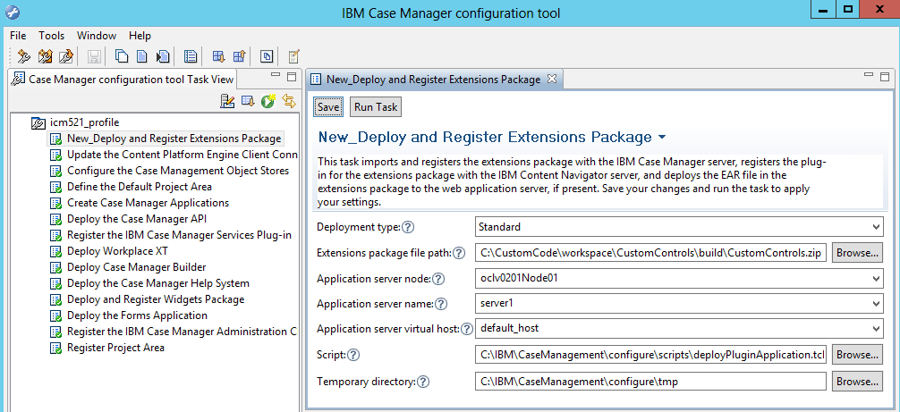
Use case: custom property editor (cont'd)
Build the ICN plugin into a jar, and then package all the files into an Extensions Package zip file. We will provide a sample build script in a future developerWorks article
Deploy the Extensions Package to the system using CMAC

Slide 24
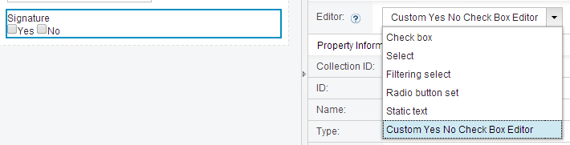
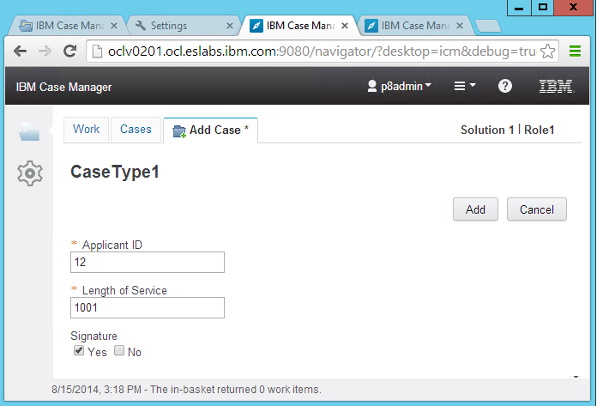
Use case: custom property editor (cont'd)
You can see the custom editor in the Editor list for the appropriate type of property in the properties view designer in Case Builder
Deploy the view, and you will be able to use it in Case Client

Slide 25
Course Roadmap
Background - the Properties View widget
Overview - extending the properties view
Extending the properties view with a scripting adapter
  Use case: customizing editor messages
Extending the properties view with an extensions package
  Use case: custom property editor
Course Summary

Slide 26
Course Summary
You have completed this course and can:
  Describe the options for extending properties view
  Choose an appropriate approach based on the business needs for customizing the properties view
  Develop custom scripts or Extensions Packages for the properties view
  Deploy and test the custom assets to the system

Slide 27
Contacts
Product Marketing Manager:
William (Doc) Mills (wdocmills@us.ibm.com)
Product Manager:
Dave Perman (dperman@ca.ibm.com)
Support:
Ted Dullanty (tdullanty@us.ibm.com)
Subject Matter Experts (SME)/Area of Expertise:
Brent Taylor (bataylor@ca.ibm.com)
Kai Zhang (kzhang@ca.ibm.com)

Slide 28
Product Help/Documentation/Resources
IBM Case Manager Knowledge Center
http://www-01.ibm.com/support/knowledgecenter/SSCTJ4_5.2.1/com.ibm.casemgmttoc.doc/casemanager_5.2.1.htm?lang=en
IBM Redbook - Customizing and Extending IBM Content Navigator
http://www.redbooks.ibm.com/abstracts/sg248055.html?Open

